Slide 1


CS3003: Functional Programming

Slide 2
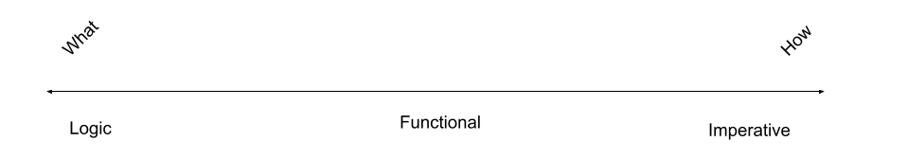
Introduction

Slide 3
Characteristics
There is no state
Functions are central
Functions can be parameters to other functions
Functions can be return values from other others
Program execution is function evaluation
Control flow is performed by recursion and conditional expressions
Lists are a fundamental data type

Slide 4
Characteristics
No variables = No state
Names refer to expressions and not their value
Not history sensitive
Has referential transparency
No loops, only recursion

Slide 5
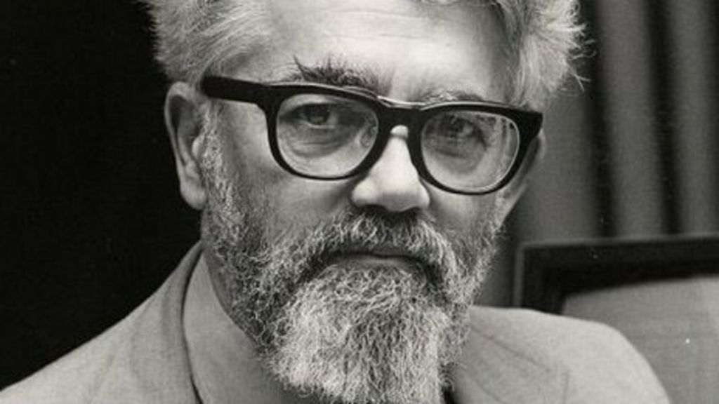
Development of Functional PLs
Developed in mid-1950s by John McCarthy

Slide 6
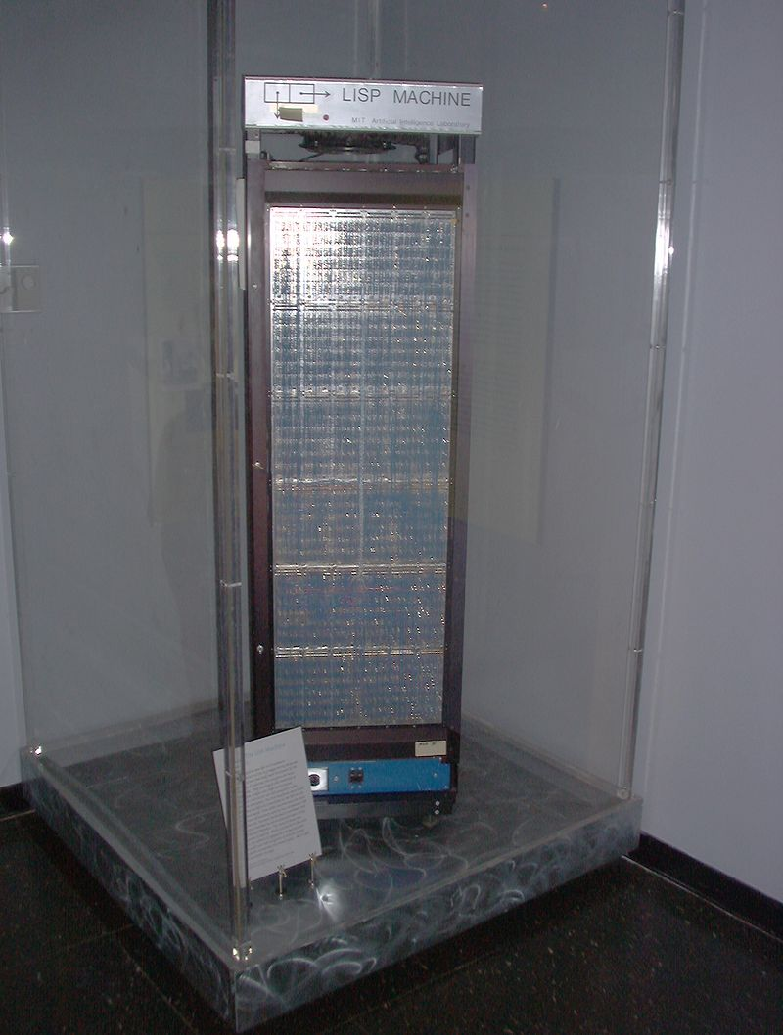
LISP machine

Slide 7
LISP operations
(car (1 2 3))
(cdr (1 2 3))
(cons (0) (1 2 3))

Slide 8
Lambda Calculus
Theoretical basis of functional programming languages
Just like how the Turing Machine is the theoretical basis of the imperative programming languages

Slide 9
Lambda Calculus
The entirety of the Lambda Calculus is made up of three entities:
1. Expression: a name, a function or an application
2. Function: λ<name> . <expression>
3. Application: <expression> <expression>

Slide 10
Examples
λx.x
(λx.x) 3

Slide 11
Examples
(λx.λy.x) = T
(λx.λy.y) = F

Slide 12
Examples
(λb.b F T) T
T F T
(λx.λy.x) F T
F

Slide 13
Examples
(λx. λy. x y F)

